Slide 1

BANKING INDUSTRY
Amulya
Nikita Singhania
Reuben Joseph
Sayonee Datta
Vinayak Mittal

Slide 2
Objectives
To identify the market share on the basis of revenue and nature of competition on the basis of Herfindal’s Index.
Segmenting the market on the basis of customers.
Conducting and Analyzing the PEST factors for Banking Sector.
Looking into other profitable business of leading Banks. (Diversification)
Ascertaining the mergers and Acquisitions in Banking Industry.
Looking into the international exposures of the banks.
To find out the technological changes in the Banking Sector.
To find out the marketing initiatives by the Banking Sector.
To look into the future outlook of the Banking Industry.
To make a comparison with US and Other developing or developed countries.

Slide 3
Market structure in Indian scenario
RBI
Scheduled
Commercial
Unscheduled
Cooperative
Public
Private
RRB
Foreign
Urban
Rural

Slide 4
Market structure in the global scenario
In the world’s top 1000 banks, there are many more large and medium-sized domestic banks from the developed countries than from the emerging economies.
Illustratively, according to The Banker 2011, out of the top 1000 banks globally,
over 200 are located in USA,
just above 100 in Japan,
over 80 in Germany,
over 40 in Spain and
around 40 in the UK.
Even China has as many as 16 banks within the top 1000, out of which, as many as 14 are in the top 500.

Slide 5
Top 10 banks in India
PUBLIC SECTOR BANKS
State Bank of India(SBI)
Punjab National Bank
Bank of Baroda
Canara Bank
Bank of India
PRIVATE SECTOR BANKS
HDFC Bank
ICICI Bank
Axis Bank
Citi Bank
IDBI Bank
thetoplist.in

Slide 6
Top 10 banks in the world
Deutsche Bank, Germany
Mitsubishi UFJ Bank, Japan
Industrial & Commercial Bank of China
HSBC Holdings, UK
Barclays PLC, UK
BNP Paribas, France
Japan Post Bank
J. P. Morgan Chase & Co. USA
Credit Agricole SA, France
Royal Bank of Scotland Group(RBS)
thetoptenz.net

Slide 7
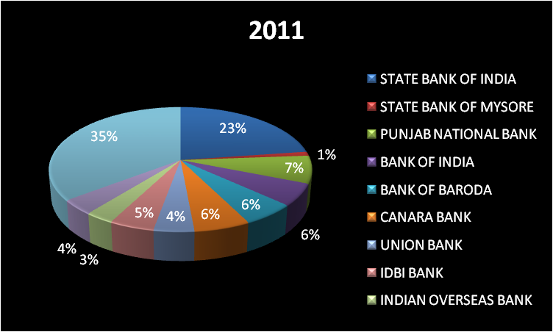
INDUSTRY CONENTRATION in public sector HERFINDAHL INDEX: source: capital line database

Slide 8
Herfindahl Index Range:-
A HHI index below 100 indicates a highly competitive index.
A HHI index below 1,500 indicates an unconcentrated index.
A HHI index 1,500 to 2,500 indicates moderate concentration.
A HHI index above 2,500 indicates high concentration.
The Herfindahl index for the public sector banks is 0.1994.
So, In Banking Industry public sector indicates moderate concentration so the concentration ratio lies between 0-50percent. So it ranges from perfect competition to oligopoly.

Slide 9
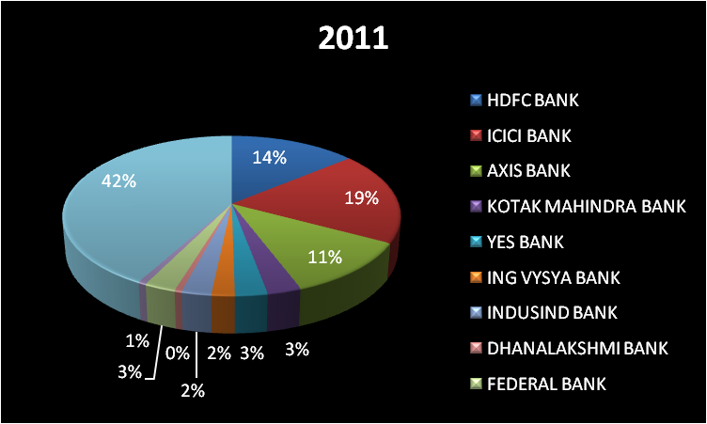
Herfindahl index in private sector source: capitaline database

Slide 10
The Herfindahl index for the private sector banks is 0.2442.
So, In Banking Industry private sector indicates moderate concentration so the concentration ratio lies between 0-50percent. So it ranges from perfect competition to oligopoly.

Slide 11
Technological & cost conditions
ATM
IT services & Mobile Banking
Virtual Wallet
Cost Conditions
The cost function controls the input prices, output quantities and other conditions- found very substantial improvements in cost productivity over time, although the improvements were smaller in last few years. Some of these improvements are clearly due to IT advances.
Eg: Previously, the automated clearing house was run primarily as batch jobs with physical delivery of computer tapes from the banks whereas the data are now sent electronically.

Slide 12
Demand conditions
demand for financial product soaring,
demand for driving down costs,
demand for leveraging technology, focusing on alternative delivery channels ,
demand for providing effective logistics for cash management to tap the rural population.

Slide 13
Conduct
Pricing
The price mix is the various interest rates charged by different banks. All the banks of India charge interest rates on the basis of RBI directives.
There is also competition among banks in terms of annual fees for services like credit cards, DMAT etc.
Interest charged on home loans and car loans are another important pricing aspect of banking industry.
In banking sector it is very important to understand that the main pricing policy is concerned with the interest rate charged.
there are mainly three types of pricing methods adopted by the banks:
Value pricing
Going rate pricing
Mark up pricing

Slide 14


Advertising
The major objectives for using advertising techniques or campaigns by banks are:
Making customers aware of the all kinds of services provided by the banks.
Increase the use of services
Creation of a proper image about banks and services
Change customers’ attitudes
Support personal selling
Emphasize well service

Slide 15
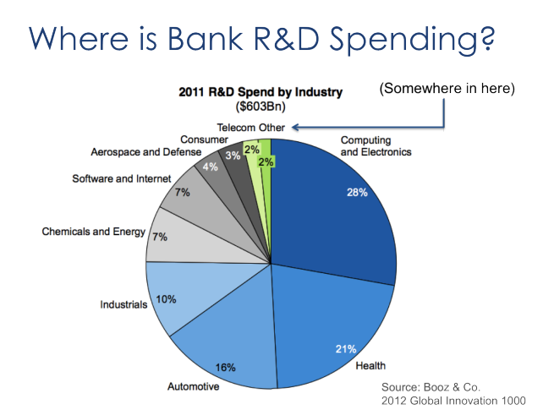
Research and development

Slide 16
Banks are lumped in to the “other” category of all industries except the top nine.
According to the FDIC, the banking industry generated more than $529 billion in revenue 2011 (net interest income + non interest income). If the industry spent at just the average rate of all industries, that would mean more than $18 billion in research and development spending. That doesn’t seem unreasonable, since the banking industry contributes about 3.6% of U.S. GDP.
That would have put the banking industry tied for 8th place with Consumer companies at 3% of the total and just ahead of Telecom. (Adjusting for the fact that the United States makes up about 31% of the total global spend, that would scale out to about 10% in total, tied for fourth place with Industrials.)

Slide 17
Mergers & acquistions
Oriental bank of commerce acquires global trust bank ltd
ICICI bank ltd acquires bank of Madura
HDFC bank acquire centurion bank of punjab
Bank of Baroda Acquires South Gujrat Local Area Bank Ltd

Slide 18
Performance
Profitability
The profitability of banking sector will remain under pressure during the year on account of market volatility, global rating agency.
The component of trading income is expected to come down.
The rate of interest income would remain the same.
The asset quality non performing loan ratio for Indian banks in 2008 is expected to move up.

Slide 19
Social welfare
Services to enterprises and consumers to undertake their business activates and to easily perform their day to day transactions.
Social insurance
Pensions
Disability insurance
Survivor benefits
Unemployment insurance
Basic Security
Rural Banking

Slide 20
Porter’s Five Force Model
Competitive Rivalry
High
Threat of new Entrants
Low
Supplier Power
Low
Availability of Substitutes
High
Buyer Power
High

Slide 21
Patents & Copyrights
innovating in the financial securities industry is very costly
financial innovations are quickly imitated by
competitors.
there is a pronounced advantage of
being first, with the innovator retaining a 50-60%market share even in the long-run.

Slide 22
Economies of scale
banking consolidation will result in a small number of large monopoly banks that can achieve substantial economies of scale and outperform small competitors.
But research suggests that small banks are sometimes more efficient than their large counterparts. One competitive strategy undertaken by numerous small banks is agricultural lending.
it is not necessary to be large to be efficient for the banks with loan specialization.

Slide 23
Capital & Liquidity Requirement
They ensure that banks are not making investments that increase the risk of failure.
They have enough capital to sustain operating losses while still honoring withdrawals.
33% raise in the capital requirements leads to 50% drop in bank entry and exit rates by small banks.

Slide 24
Economies of scope
During the period characterized by rapid growth and considerable regulation of the capital market, banks sought to reduce fixed unit costs by expanding their landing and deposit bases.
In such situations, their quantitative expansions-supported by prevailing competitive parity among banks could increase profits.
Thus banks seek to maximize a kind of economy of scale by increasing output of single products.
Economies of scope will provide the theoretical foundation for the diversification of the banking industry in an era of slower economic growth and advances in economic technologies.

Slide 25
PESTLE ANALYSIS
Political
Economic
Social
Technological

Slide 26
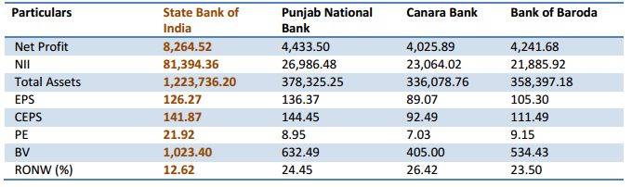
Comparison between Peers in public sector

Slide 27
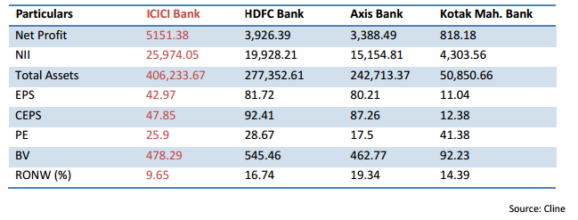
Comparison Between Peers in private sector

Slide 28
Comparison of Indian banking system with global banking system
Russia
USA
Australia
Brazil
China

Slide 29
Future outlook
Two critical factors driving change over the next 10-20 years: firstly, India has a large number of young population in the country and will see a sharp rise in its working age population. Secondly, more people in India will get rich within one generation.
A study by Mc Kinsey suggests that average households income will triple over the next two decades and it will become the world’s fifth largest consumer economy by 2025.

Slide 30
The demand for financial services will increase ant the banking and the financial sector will have a key role in intermediating savings and investment from large number and growing incomes, which will fuel growth.
It is estimated that under the Unique Identification Authority of India, by 2017 nearly 1.2 billion people in the country would be enrolled under Aadhaar.

